Slide 1

Unsupervised clustering for putative dopamine neuron identification from tetrode recordings in behaving mice
Hanbing Shen
Supervisor: Prof. Uchida Naoshige, Harvard University
28th April, 2021
Notes:
Hello everyone, I am Hanbing Shen. My thesis project is Unsupervised clustering for putative dopamine neurons identification from tetrode recordings in behaving mice.

Slide 2
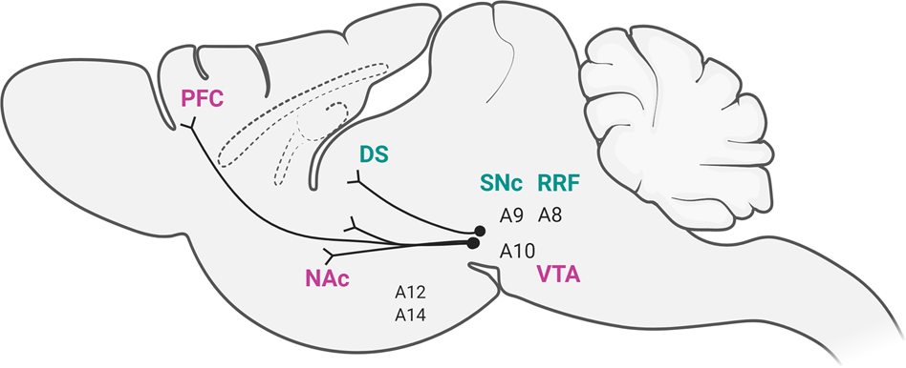
Dopamine and midbrain dopamine (DA) neurons
(Baik, J. 2020)
Notes:
https://www.nature.com/articles/s12276-020-00532-4
The neurotransmitter dopamine in the brain has been identified for its extensive and diverse roles in motivation and learning. Midbrain dopamine (DA) neurons are mainly located in the ventral tegmental area (VTA) and substantia nigra pars compacta (SNc), projecting to striatum and prefrontal cortex. Multiple unproven hypotheses regarding the spiking activity of VTA DA neurons and behaviors require additional studies to dissect midbrain DA neurons from circuits to behaviors.
**SNc mDA neurons project to the dorsal striatum via the nigrostriatal pathway. The VTA and RrF mDA neurons project to ventral striatum and prefrontal cortex forming the mesocortical and mesolimbic dopaminergic system.

Slide 3
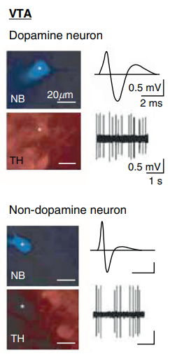
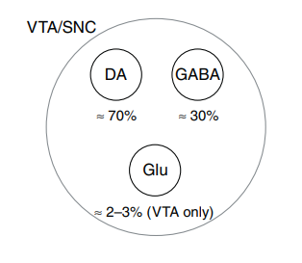
Extracellular recordings from midbrain DA neurons in vivo
(Mark and Grace, 2012)
（Ungless,2004)
Notes:
In vivo extracellular recordings do provide a powerful tool to understand the midbrain DA system. Although about 70% of neurons in midbrain are DA neurons, one challenge in dissecting midbrain DA neurons is to distinguish putative DA (pDA) neurons from other neuron types during recordings, such as GABAergic, glutamatergic or co-releasing neurons. For a long time, a criterion to identify pDA neurons was based on the electrophysiological properties of recorded neurons, including slow baseline firing rate and wider spike waveform.

Slide 4
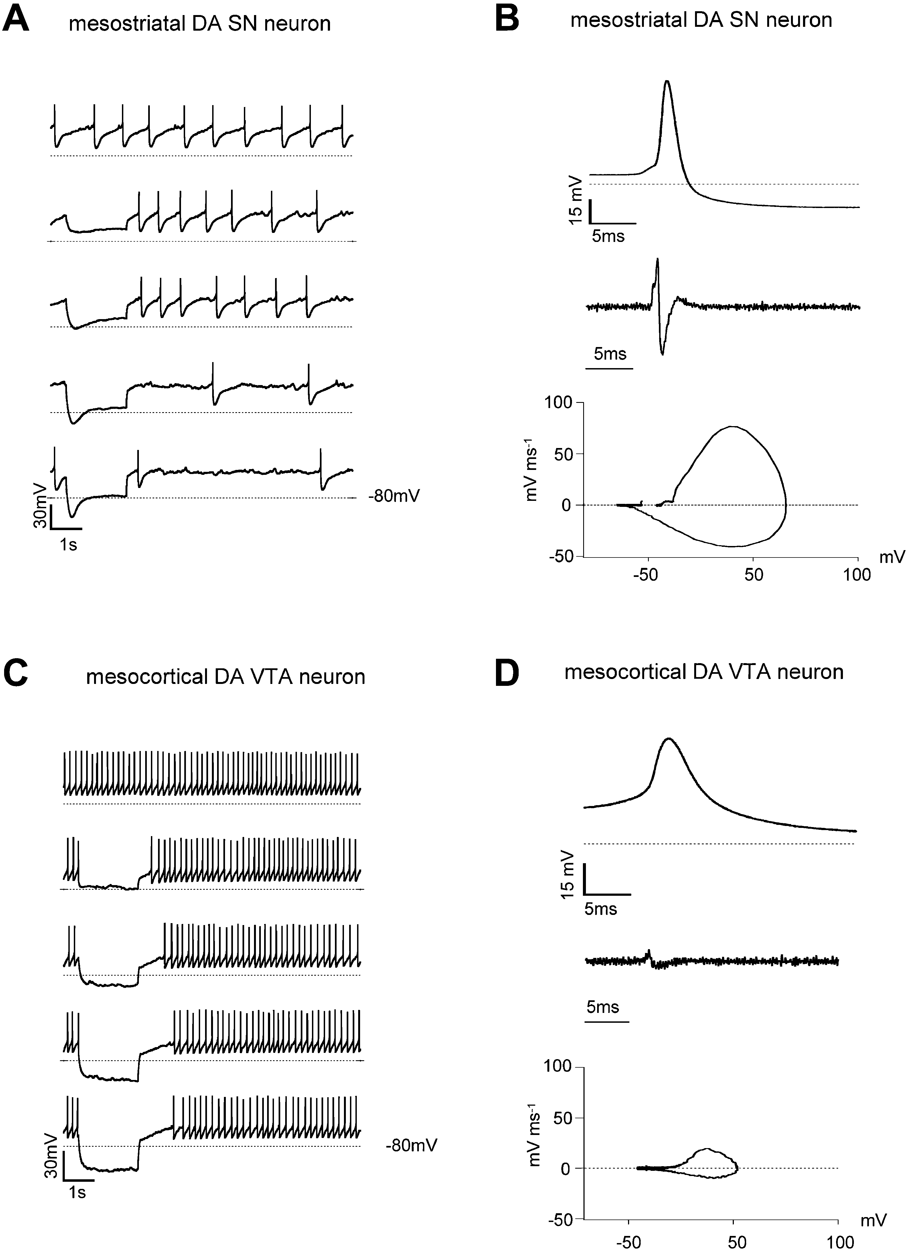
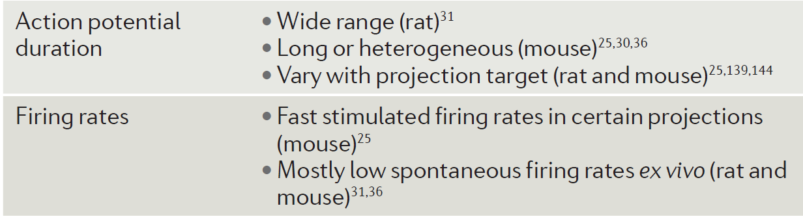
Heterogeneous electrophysiological properties of midbrain DA neurons
(Lammel et al., 2008)
(Morales and Margolis, 2017)
Notes:
However, midbrain DA neurons actually have heterogeneous electrophysiological properties. For example, Lammel and his group has identified a an atypical fast-firing subtype of DA neurons, mesocortical DA VTA neuron, compared to mesostriatal SN neuron. Also, other electrophysiological properties like action potential duration could vary with projection target. Therefore, no single electrophysiological property can define the DA group.

Slide 5
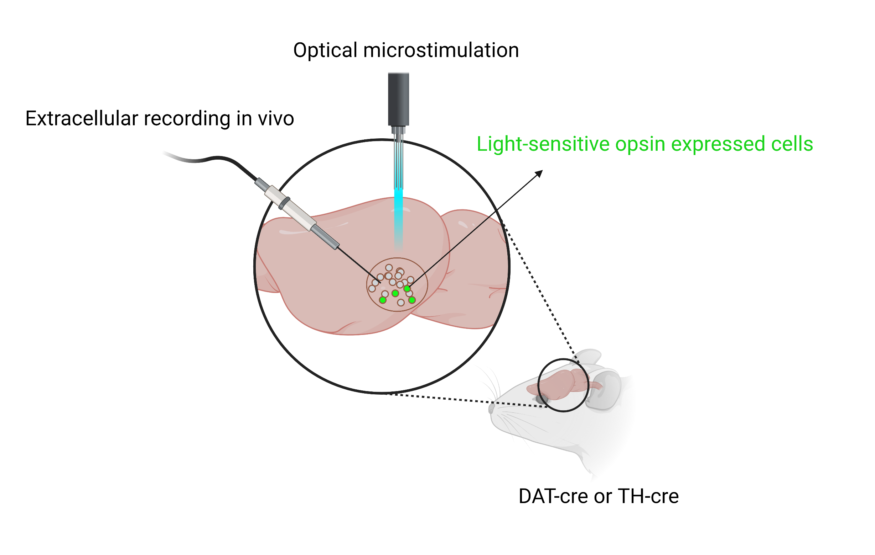
Optotagging links in vivo spike trains to genetically defined DA neurons
Notes:
Then, the advent of optotagging makes it possible to link extracellular spike measurements to genetically define cell classes. It directly photo-stimulates cells that express a light-sensitive opsin under genetic control. We can use transgenic Cre-driver mouse lines DAT-Cre or TH (tyrosine hydroxylase)-Cre lines to let DA neurons express a light-sensitive opsin.

Slide 6
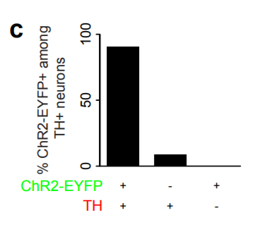
Limitations of Optotagging
Time-consuming, incomplete virus expression (Cohen et al., 2012), a limited scope (Lammel et al., 2008) (Jia et al., 2018)
Only about 25% recorded neurons are photo-identified DA neurons (Cohen et al., 2012)
(Cohen et al., 2012)
Notes:
However, Optotagging is largely restricted to transgenic systems, which is time consuming. And also, incomplete virus expression (10% of TH-labled cells did not express virus) and a limited scope → low detection ratio. In Cohen’s paper, Only 25% recorded neurons are photo-identified DA neurons, which are far fewer than the actual value, 70%.
*In our dataset, Only 25% recorded neurons are photo-identified DA neurons

Slide 7
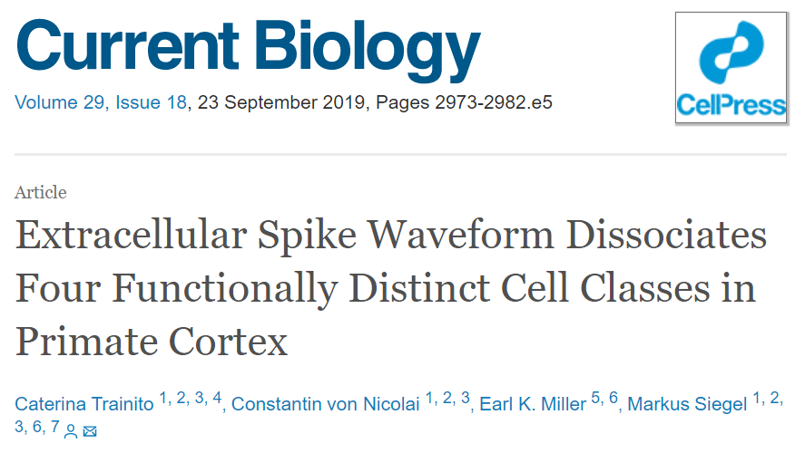
Unsupervised clustering methods for neuron identification
Notes:
Considering the limitations of optotagging, how to improve it? It is of great interest to combine electrophysiological properties with optotagging (to enhance the sensitivity and maintain the specificity of DA neuron identification). However, given the heterogeneity of DA neurons in electrophysiological properties, DA neurons are indistinguishable from non-DA neurons by humans. Therefore, a more automated methodology is required. Unsupervised learning can learn patterns and group data from unlabeled data. Several attempts have been made to apply quantitative methods using unsupervised clustering methods to classify neurons based on their electrophysiology properties. The left paper has identified four waveform-based cell classes in primate cortex by using GMM, one unsupervised method. The right preprint has conducted an unsupervised cluster analysis on DA neurons.

Slide 8

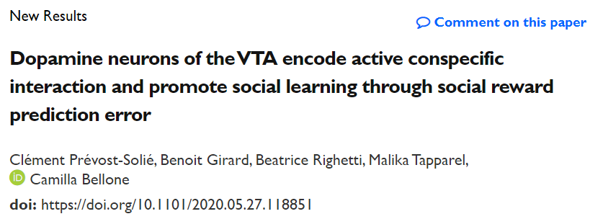
Unsupervised clustering methods for neuron identification
Notes:
Considering the limitations of optotagging, how to improve it? It is of great interest to combine electrophysiological properties with optotagging (to enhance the sensitivity and maintain the specificity of DA neuron identification). However, given the heterogeneity of DA neurons in electrophysiological properties, DA neurons are indistinguishable from non-DA neurons by humans. Therefore, a more automated methodology is required. Unsupervised learning can learn patterns and group data from unlabeled data. Several attempts have been made to apply quantitative methods using unsupervised clustering methods to classify neurons based on their electrophysiology properties. The left paper has identified four waveform-based cell classes in primate cortex by using GMM, one unsupervised method. The right preprint has conducted an unsupervised cluster analysis on DA neurons.

Slide 9
Can unsupervised clustering methods link electrophysiological properties’ analysis with optotagging for unbiased and quantitative large-scale putative DA (pDA) neuron identification?
Notes:
Therefore, I was wondering whether unsupervised clustering methods could link electrophysiological properties’ analysis with optotagging for unbiased and quantitative large-scale putative DA neuron identification.

Slide 10
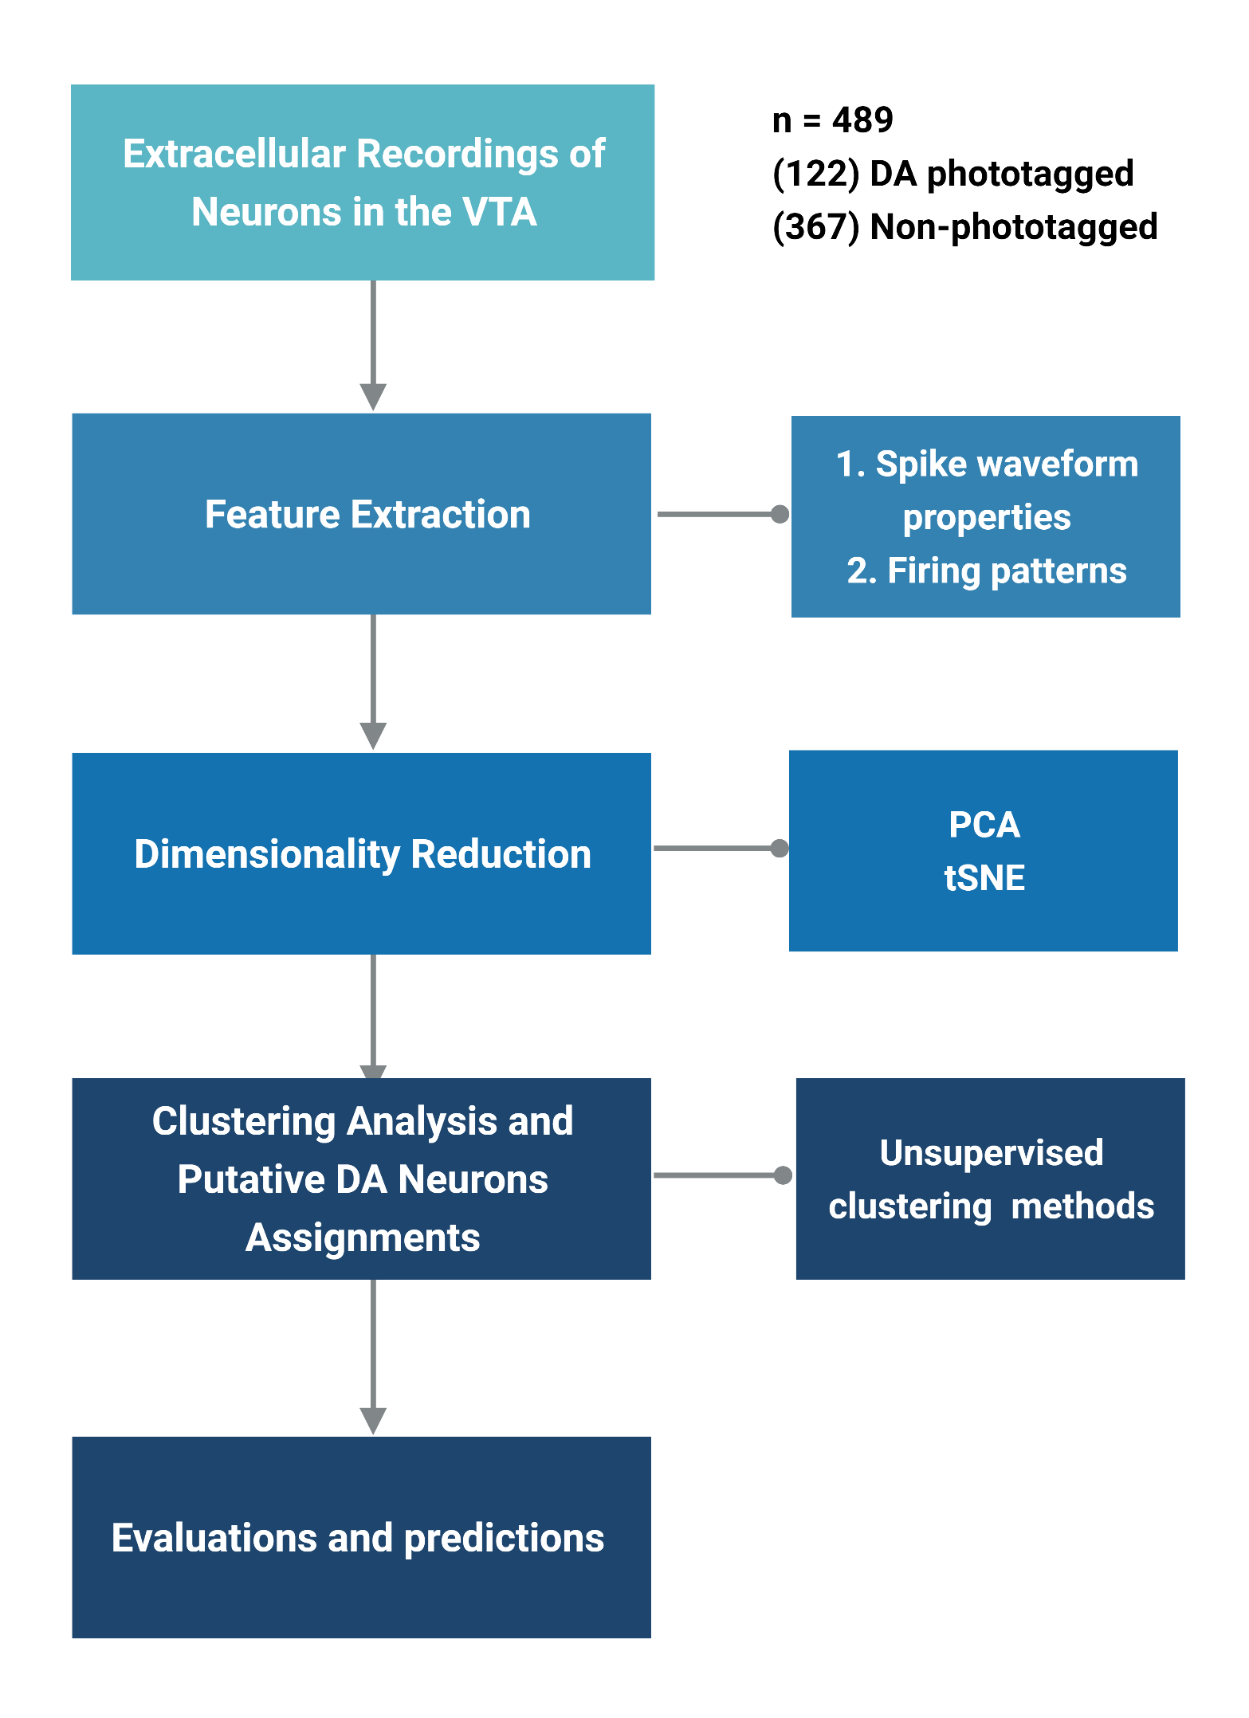
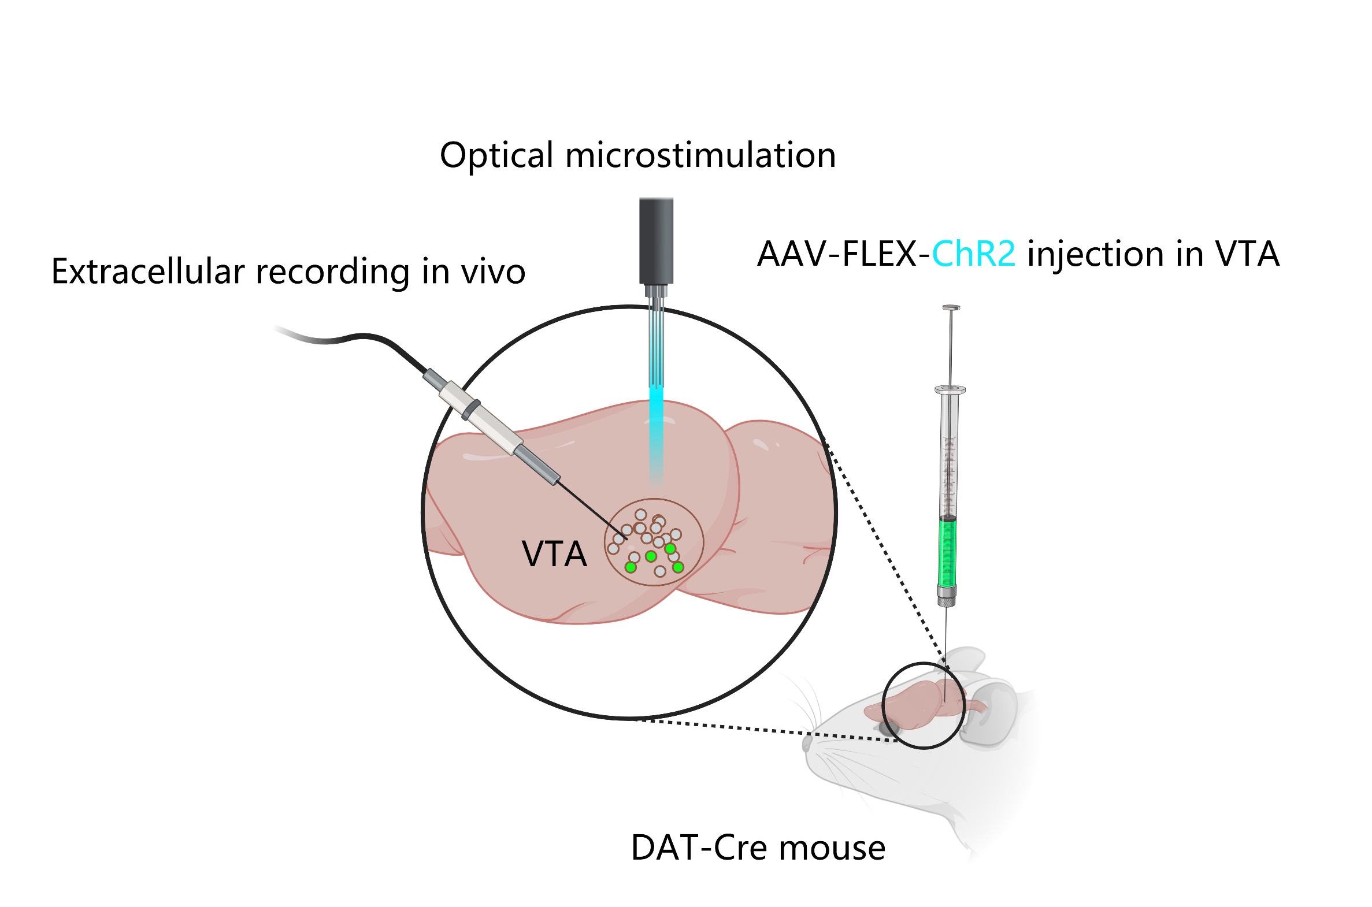
Introduction
Data source: HyungGoo Kim
Notes:
So to answer this question and to increase the number of detected dopamine neurons in any recording session. The first goal of my project is to extract electrophysiological properties of recorded neurons to serve as important parameters that will be used in the following analysis. The second goal is to use unsupervised clustering methods based on extracted features to identify additional putative dopamine neurons that might have been missed by the opto-tagging technique.
Here, I used data from the extracellular recordings of neurons in the VTA from from male DAT-cre mice with the optotagging technique. 489 neurons were recorded in total, and 122 of them are photoidentified DA neurons.
Then I will first extract spike waveform properties and firing patterns for feature extractions. Then, after dimensionality reduction, I will conduct clustering analysis and group pDA and non-Pda neurons by different unsupervised clustering methods. Finally, I will evaluate and compare the model performance and make model predictions.
*ChR2 (H134R)-EYFP flanked by double loxP
Male DAT-Cre mice were injected with Cre-dependent AAV virus expressing ChR2 in the VTA. Pulses of light were given to activate ChR2 and classify neurons as photoidentified DA neurons or unidentified neurons

Slide 11
Introduction
Data source: HyungGoo Kim

Slide 12
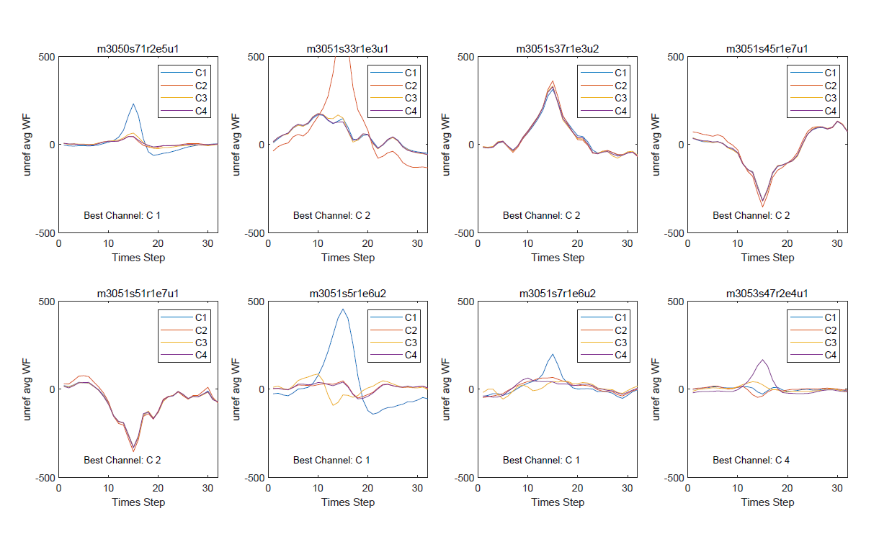

Slide 13
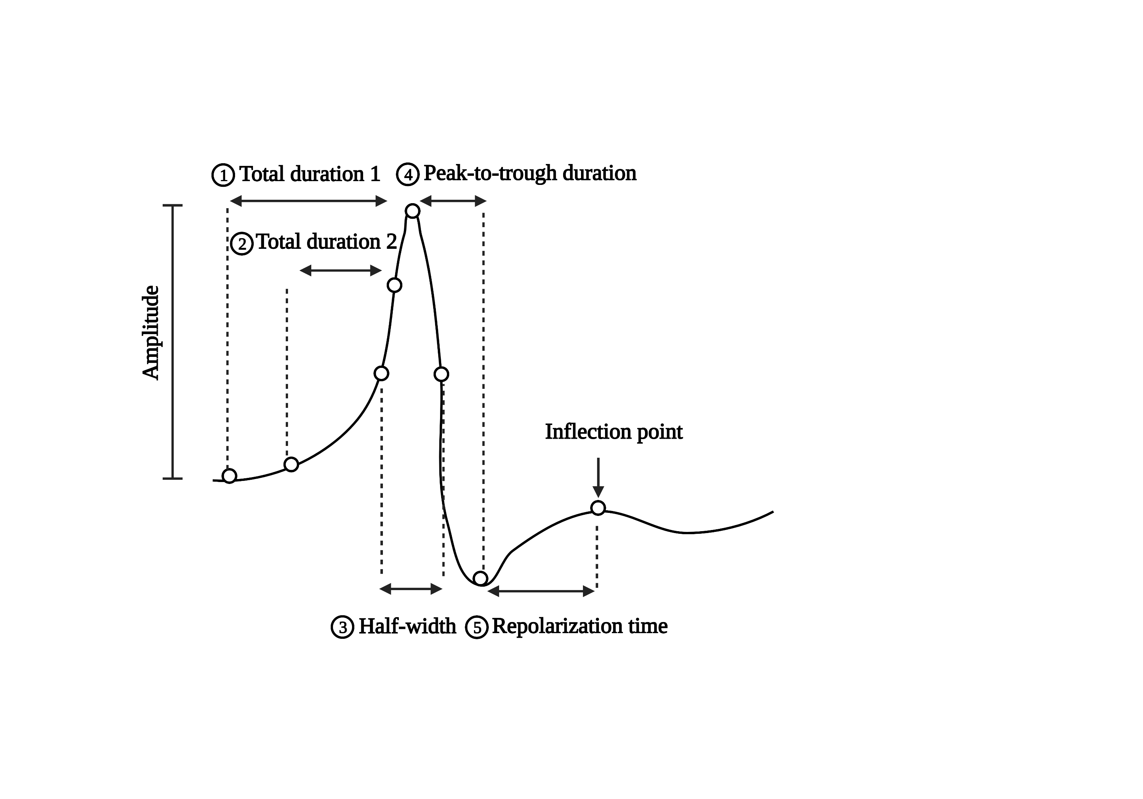
Spike waveform properties
(Gale and Perkel, 2016) (Trainito et al. 2019) (Markham and Stoddard, 2015)
Notes:
After curve fitting, I extracted the following five Spike waveform properties: two total durations, , Half-width, trough-to-peak duration, and repolarization time. The first total duration is the distance between the baseline and the peak. The second total duration is the distance between the point that reaches 10% of the amplitude of the global peak and the point that returns to 10% of the amplitude before this peak. The third feature, the half-width is the duration at half-amplitude (Markham and Stoddard, 2015). The peak-to-trough duration is from the global maximum to the following local minimum if the predominant peak is positive-going, while this is from the global minimum to the following local maximum if the predominant peak is negative-going. The repolarization time is the distance between the local extreme and the inflection point after this peak.

Slide 14
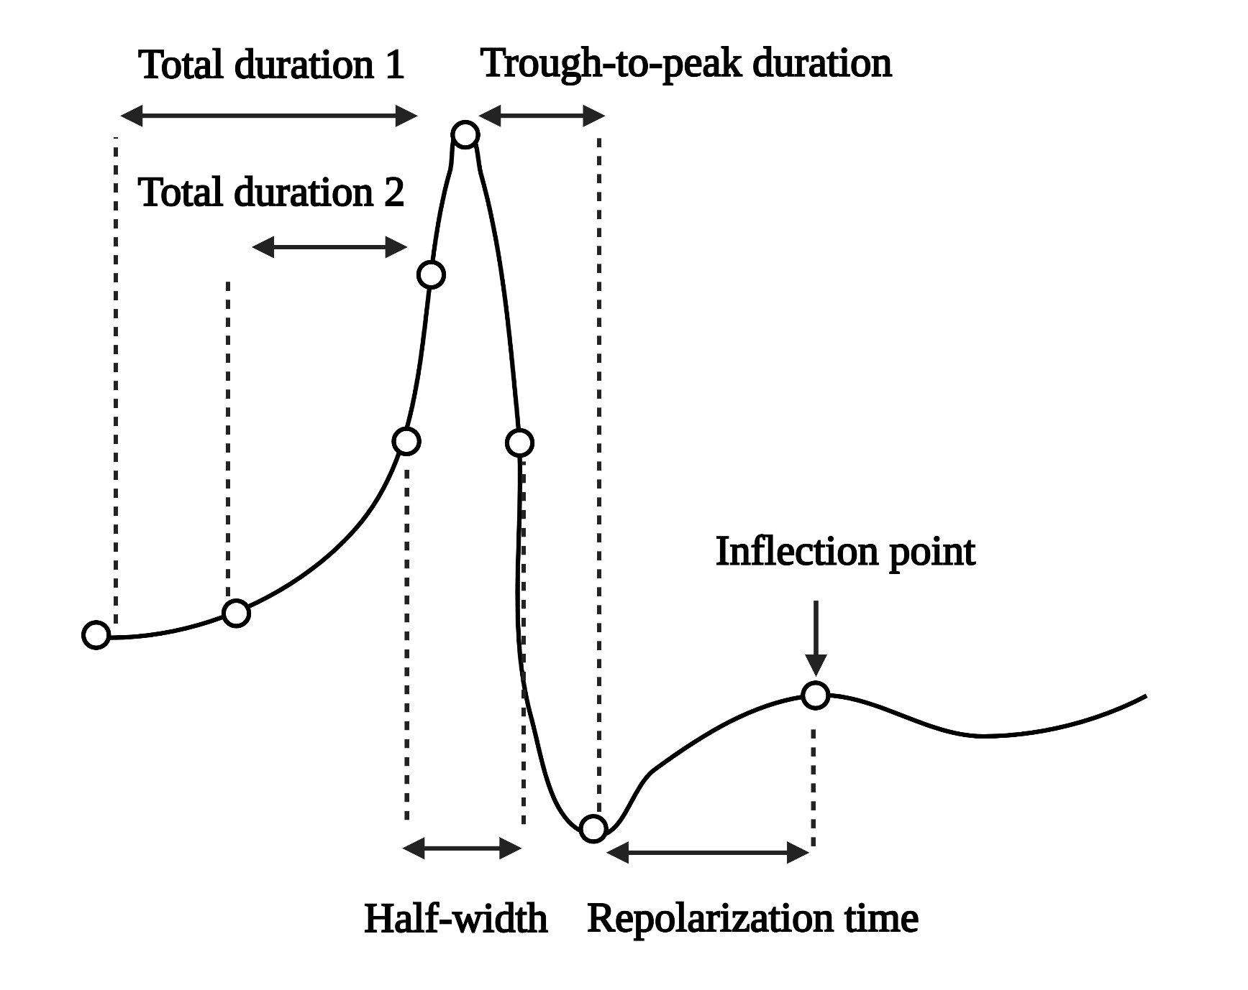
Spike waveform properties
(Gale and Perkel, 2016) (Trainito et al. 2019) (Markham and Stoddard, 2015)
Notes:
After curve fitting, I first extracted the following five Spike waveform properties: two total durations, , Half-width, trough-to-peak duration, and repolarization time.
The total duration is the distance between the point that reaches 10% of the amplitude of the global peak and the point that returns to 10% of the amplitude after this peak. The peak-to-trough duration is from the global maximum to the following local minimum if the predominant peak is positive-going, while this is from the global minimum to the following local maximum if the predominant peak is negative-going. The repolarization time is the distance between the predominant peak and the inflection point after this peak (Trainito et al., 2019). The half-width is the duration at half-amplitude (Markham and Stoddard, 2015).

Slide 15
Representative extractions
Notes:
Here are some representative extractions of waveform features. The y axis represents the amplitude of waveform, and x axis represents the time step. The blue line is the neuron waveform after curve fitting. Between the green dotted lines are the first total duration, between the pink dotted lines are the second total duration.

Slide 16
Representative extractions
Notes:
Between the pink dotted lines are half-width

Slide 17
Representative extractions
Notes:
Red point is the global peak, and the blue point is the trough, and green point is the inflection. So it can extract peak-to-trough duration and repolarization time.

Slide 18
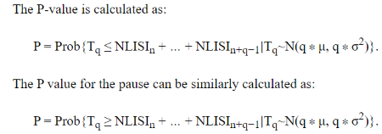
Firing properties and the Robust Gaussian Surprise (RGS) method
Normalize each spike train by subtracting the central location, from ln(ISI).
→ NLISI
Define burst threshold (0.5 percentile of the central distribution) and pause threshold (99.5 percentile)
From each NLISI in the seed set, extend it to a set of the consecutive string of NLISIs，until the string reaches the smallest P-value
Notes:
The normalized log (ISI) generates a cumulative Gaussian probability distribution,
Median + or – 2.58 times the median average deviations
assuming a Gaussian distribution with mean and standard deviation taken from the normalized log10 ISI distribution.

Slide 19
Firing properties
Burst, Tonic, Pause
Burst
Pause
Interspike interval (ISI)
Notes:
For the firing patterns, the response of neurons is composed of a series of spikes separated by long or short intervals. The spikes in burst patterns are more dense, while the spikes in pause patterns are more sparse. The remaining belong to tonic patterns. The arrangement of differential interspike intervals (ISIs) defines the neuronal firing pattern.

Slide 20
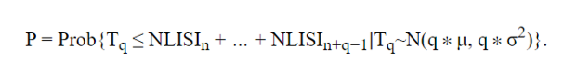
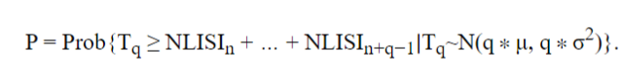
Pause and Burst quantification by Robust Gaussian Surprise (RGS) method
Normalize each log-transformed ISI (NLISI)
Define burst threshold (0.5 percentile) and pause threshold (99.5 percentile)
From each NLISI in the seed set, extend it to a set of the consecutive string of NLISIs, until the string reaches the smallest P-value
Burst
Pause
Notes:
To detect pause and burst in DA neurons, I utilized RGS method, a statistical method. It first normalizes the log-transfomed ISI in each spike train, which generates a cumulative Gaussian probability distribution. Then it defines burst threshold and pause threshold based on the 0/.5 percentile and 99.5 percentile of this central distribution respectively. Finally, From each NLISI in the seed set, extend it to a set of the consecutive string of NLISIs，until the string reaches the smallest P-value

Slide 21
Pause and Burst quantification by Robust Gaussian Surprise (RGS) method
Normalize each log-transformed ISI (NLISI)
Define burst threshold (0.5 percentile) and pause threshold (99.5 percentile)
From each NLISI in the seed set, extend it to a set of the consecutive string of NLISIs，until the string reaches the smallest P-value
(Ko et al., 2012)
Burst
Pause
Notes:
But how to detect pause and burst in DA neurons?
In RGS method, it first normalize the log-transfomed ISI in each spike train. It generates a cumulative Gaussian probability distribution. Then it defines burst threshold and pause threshold based on the 0/.5 percentile and 99.5 percentile of this central distribution respectively. Finally, From each NLISI in the seed set, extend it to a set of the consecutive string of NLISIs，until the string reaches the smallest P-value

Slide 22
Normalize each spike train by subtracting the central location, from ln(ISI).
→ NLISI
Define burst threshold (0.5 percentile) and pause threshold (99.5 percentile)
From each NLISI in the seed set, extend it to a set of the consecutive string of NLISIs，until the string reaches the smallest P-value

Slide 23
Firing properties
1. Duration
2. Intraburst/pause/tonic frequency
3. Number of spikes
Median
Coefficient of variation
Kurtosis
Mean
Bursts & Pauses & Tonics
Skewness
4. Within burst/pause/tonic ISIs
5. Instantaneous firing frequency
Total duration
IntraXX frequency (IXF)
e.g. Pauses.NumSpikes./(Pauses.Windows(:,2) - Pauses.Windows(:,1)
b) Instantaneous Reciprocal to the length of current inter-spike interval.
(Pauluis and Baker, 2000) (Kostal et al., 2018) (Prevost et al. 2020)
Notes:
After detecting the pause and burst, we can divide the whole spike train into bursts, pauses and tonics. Here I first extracted the total duration of each firing pattern. And then I extracted duration, intrapattern frequency, number of spikes, within pattern ISIs, and instantaneous firing frequency, and then analyzed their distributions by calculating the following five values: mean, median, variantion, kurtosis, and skewness.
**Kurtosis is a measure of whether the data are heavy-tailed or light-tailed relative to a normal distribution.
** Skewness is a measure of the asymmetry of the data around the sample mean. If skewness is negative, the data spreads out more to the left of the mean than to the right. If skewness is positive, the data spreads out more to the right. The skewness of the normal distribution (or any perfectly symmetric distribution) is zero.

Slide 24
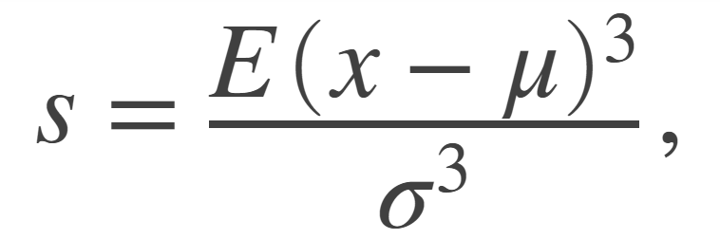
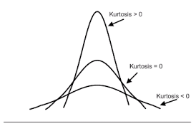
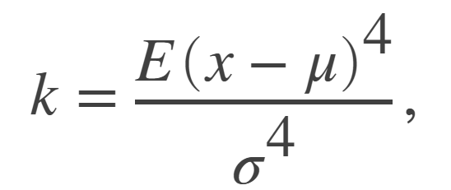
Skewness
Kurtosis

Slide 25
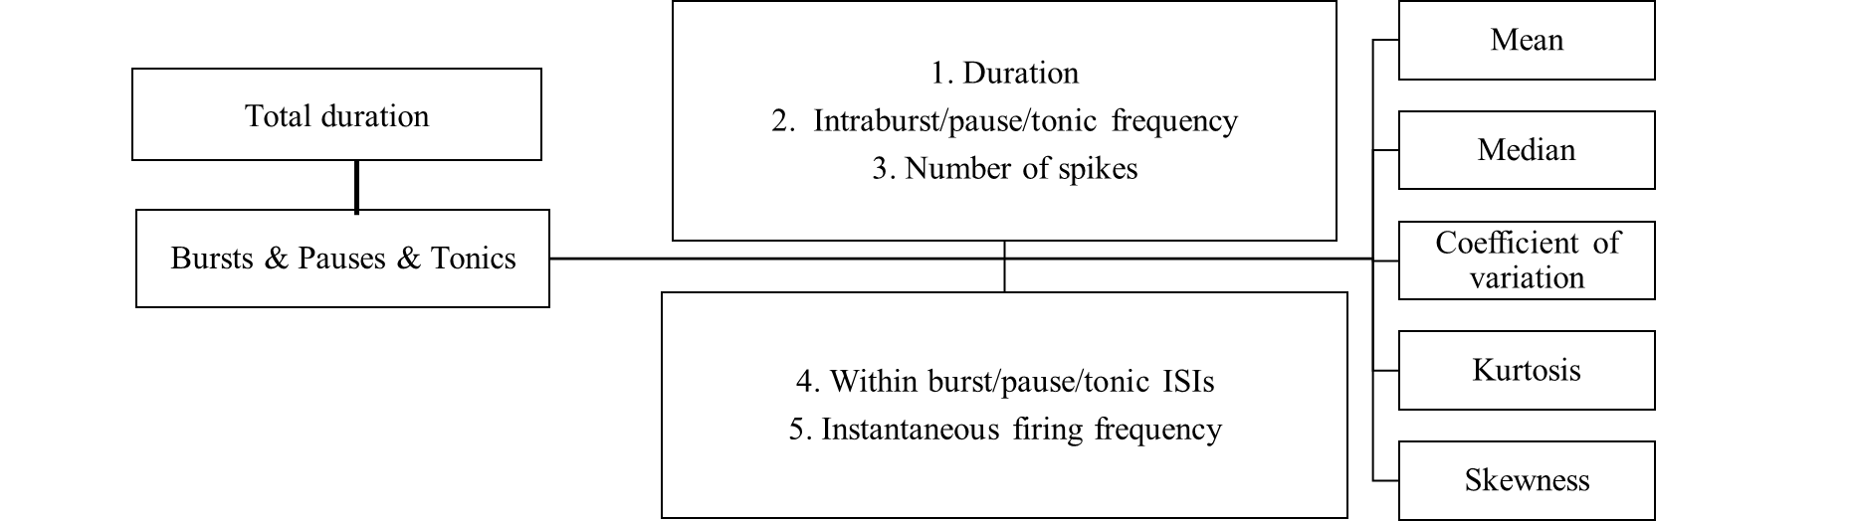
58 features extracted
Notes:
In total, 58 features have been extracted

Slide 26
Principal component analysis for dimensionality reduction and t-SNE
A.
C.
B.
Notes:
After applying Z-score normalization on each feature, I perform PCA for dimensionality reduction. As shown in Figure A, 38 PCs were chosen to explain 99% variations in initial dataset. Figure B shows the 3D-scatter plot of DA-phototagged and Non-phototagged neurons marked as different color. Then I performed t-SNE to visualize this high-dimensional data. In figure C, you can see the yellow DA phototagged neurons are almost in the same cluster.

Slide 27
Data source: HyungGoo Kim
Notes:
. Then, to test whether these neurons can be assigned in the same cluster and whether this cluster can contain more Nonphototagged neruons. I tried different unsupervised clustering methods.

Slide 28
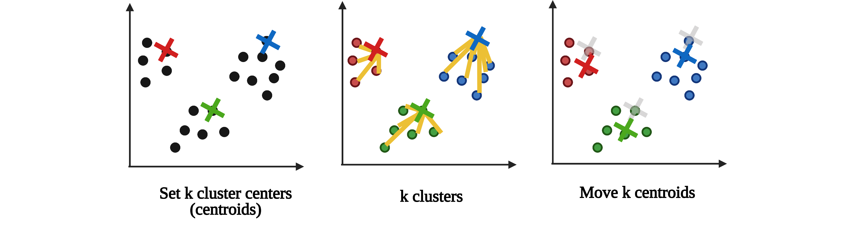
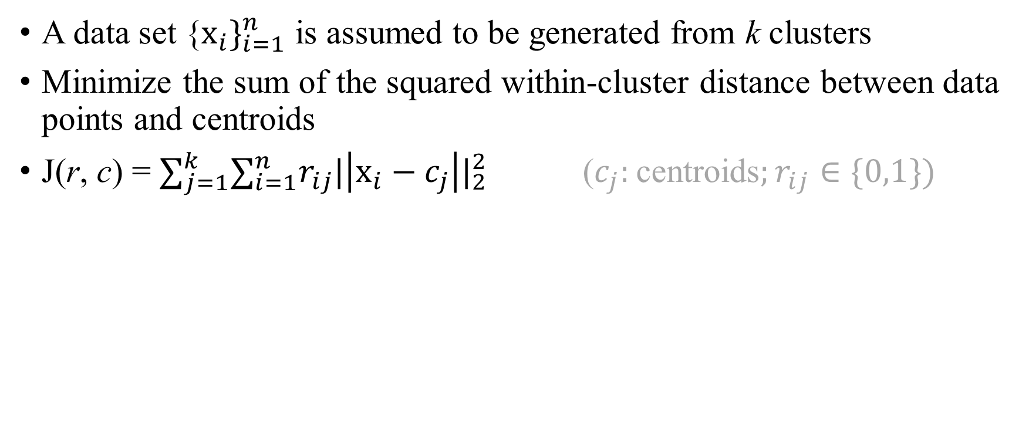
K-Means
A data set {$x_{i}\}_{i=1}^{n}$ is assumed to be generated from k clusters
Minimize the sum of the squared within-cluster distance between data points and centroids
J(r, c) = $∑_{j=1}^{k}{∑_{i=1}^{n}r}_{ij}|\left|x_{i}−c_{j}\right||_{2}^{2}$ ($c_{j}:$centroids$;r_{ij}∈\{0,1\})$
Notes:
K-means is an iterative method. It aims to partition n observations into a given number of clusters. The algorithm starts with an initial guess for the cluster centers, the cluster centers can be a point that is not an actual data point. and each observation is placed in the cluster to which it is closest. It aims to minimize the sum of the squared Euclidean distance between data points and centroids. So, the cluster centers are then updated, and the entire process is repeated until the cluster centers no longer move. Mathematically, K-means aims to minimize this formula. X is a data point, c is the centroid in each cluster, r is a binary value, when r is equal to 1, xi is assigned to cluter j.
**But it does not guarantee a convergence to a global optimum, because it final clustering heavility dependent on initial centroids, K-means treats each feature equally, regardless of its actual degree of relevance to the problem. When analyzed mathematically, it aims to minimize this formula. X means a data point, c represents the centroid in each cluster. The squared Euclidean distance is then multiplied by the binary parameter r. If a x is assigned to the cluster j, r is 1.

Slide 29
Different clustering models
Notes:
Here are the clustering results in 3d t-SNE scatter plots. X,Y,Z axis are three t-SNE dimensions. The blue filled points correspond to Non-phototagged neurons while the yellow filled points correspond to phototagged DA neurons. As for the clustering results, the red borders correspond to non-putative DA neurons while the green borders correspond to putative DA neurons. TP is true positive rate, representing the proportion of phototagged DA neurons that are assigned to putative DA group. The second number is the proporion of putative DA neurons among all neurons. Here, in K-means model, the true positive rate is 100%. All true DA neurons are assigned in the same cluster. The propotion of Pda is 75%, which is very close to the real situation.

Slide 30
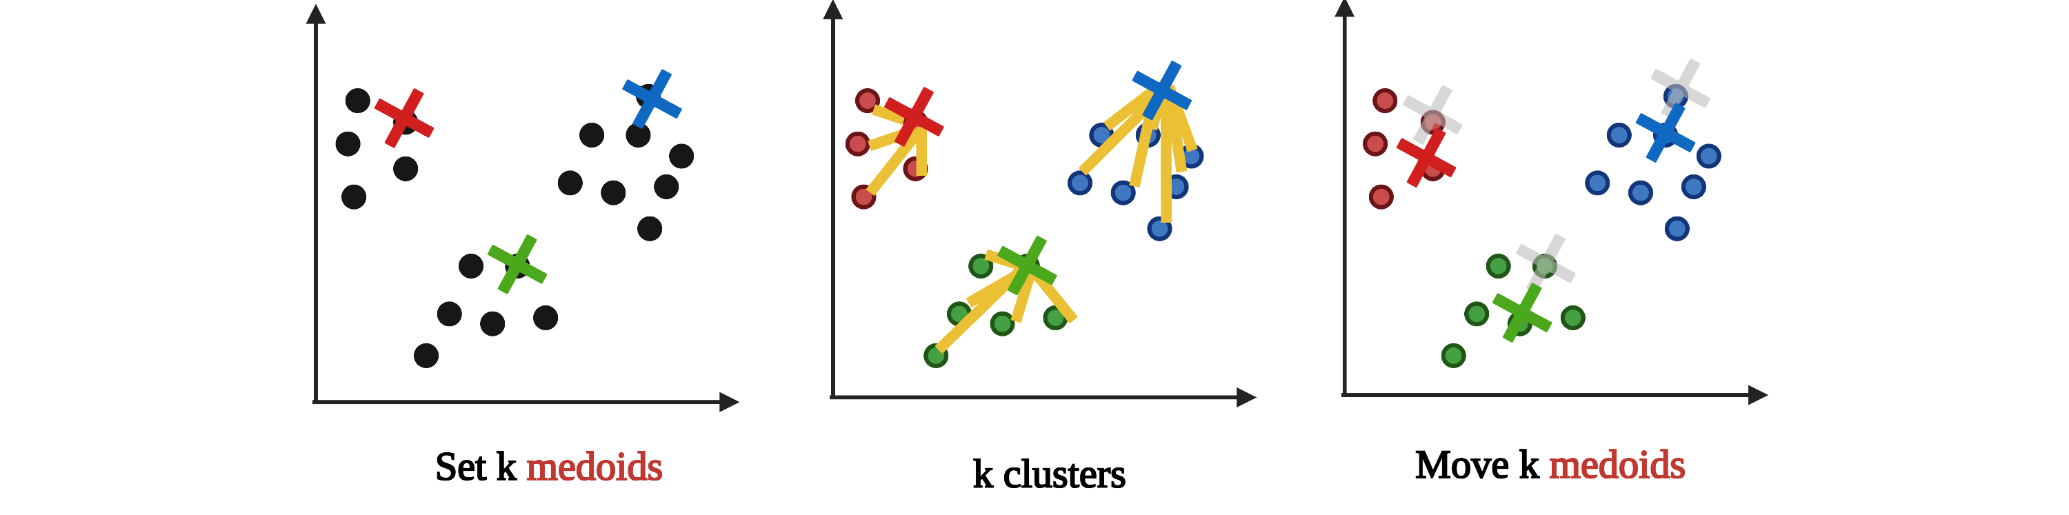
K-Medoids
K-Medoids chooses actual data points as centers
Notes:
In contrast to the k-means algorithm, k-medoids chooses actual data points as centers.
The remaining steps are similar to K-means. Since it uses the actual points in the data set, so it is not very sensitive to the outliers.
In contrast, k-means is sensitive to outliers.

Slide 31
Different clustering models
Notes:
Although the true positive rate is very high, this model is unable to distinguish pDA from non-pDA

Slide 32
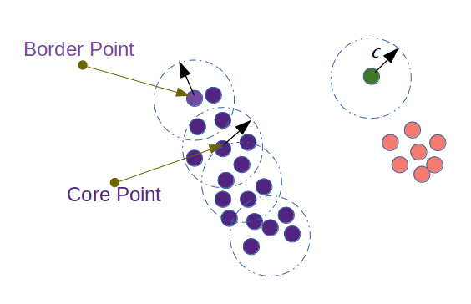
Density-based spatial clustering of applications with noise (DBSCAN)
Outlier
Works based on density of objects
R (Radius of neighborhood )
M (Min number of neighbors)
R
Notes:
https://towardsdatascience.com/dbscan-algorithm-complete-guide-and-application-with-python-scikit-learn-d690cbae4c5d
DBSCAN is another common method for class identification. It locates regions of high density, and can separate outliers.
It works based on two parameters. The first is R, radius of neighborhood. If a radius includes enough number of points within, we call it a dense area. The second parameter is M. The minimum number of neighbor required to define a cluster.
Here if we define R =2, M =6. we can define a point as a core point, since it has 6 neighbors around it. Also, we can define a data point as a border point if it does not have enough points in the neighborhoods. An outlier is a point that is not reachable from any other point. Then after all points are labeled, this method connects core points that are neighbors and put them in the same cluster. Here we can see the purple points are in the same cluster, and the pink points are in another cluster.

Slide 33
Density-based spatial clustering of applications with noise (DBSCAN)
Outlier
Works based on density of objects
R (Radius of neighborhood )
M (Min number of neighbors)
R
R = 2 unit
M = 6
Notes:
https://towardsdatascience.com/dbscan-algorithm-complete-guide-and-application-with-python-scikit-learn-d690cbae4c5d
DBSCAN is another common method for class identification. It locates regions of high density, and can separate outliers.
It works based on two parameters. The first is R, radius of neighborhood. If a radius includes enough number of points within, we call it a dense area. The second parameter is M. The minimum number of neighbor required to define a cluster.
Here if we define R =2, M =6. we can define a point as a core point, since it has 6 neighbors around it. Also, we can define a data point as a border point if it does not have enough points in the neighborhoods. An outlier is a point that is not reachable from any other point. Then after all points are labeled, this method connects core points that are neighbors and put them in the same cluster. Here we can see the purple points are in the same cluster, and the pink points are in another cluster.

Slide 34
Different clustering models

Slide 35
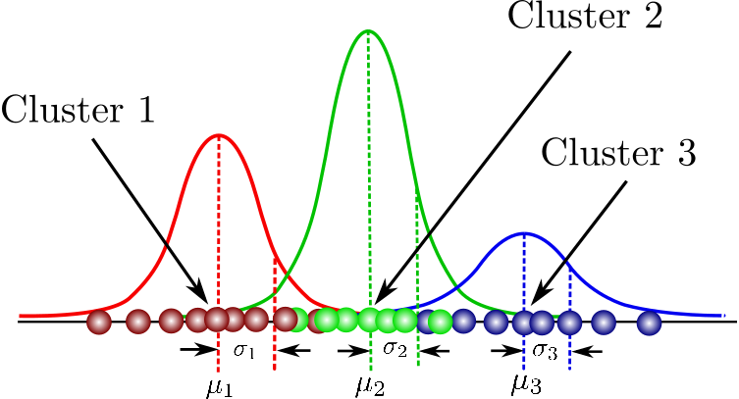
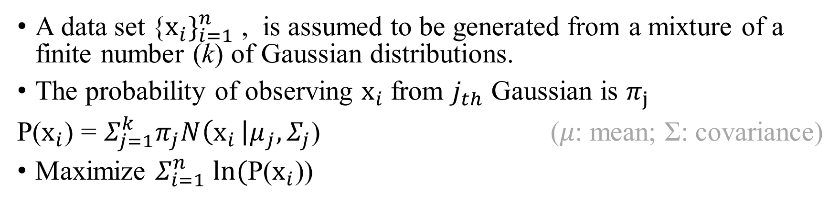
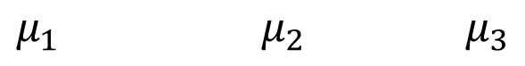
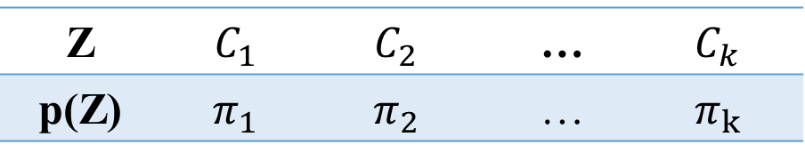
Gaussian Mixture Model (GMM)
A data set {$x_{i}\}_{i=1}^{n}$ , is assumed to be generated from a mixture of a finite number (k) of Gaussian distributions.
The probability of observing $x_{i}$from $j_{th}$ Gaussian is $π_{j}$
P($x_{i}$) = $Σ_{j=1}^{k}π_{j}N\left(x_{i }\right|μ_{j}, Σ_{j}\text{)}$ (𝜇: mean; Σ: covariance)
Maximize $Σ_{i=1}^{n}$ $ln($P($x_{i}$))
k clusters, k Gaussians
x: observed variable
Z: latent variable
Z | $$C_{1}$$ | $$C_{2}$$ | … | $$C_{k}$$
p(Z) | $$π_{1}$$ | $$π_{2}$$ | … | $$π_{k}$$
$$μ_{1 }μ_{2 }μ_{3}$$
$Σ_{j=1}^{k}π_{j}$ =1
Notes:
Similar to K-means, GMM requires you to specify the number of clusters before fitting the model. But k-means gives exactly how each sample is assigned to a certain cluster, which is called hard assignment. However, GMM gives the probabilities of the data point belonging to each of the possible clusters, reflecting the level of uncertainty. Here, given an observed variable x, it is assumed to be generated from a mixture of gaussian distributions. We can use a latent variable z to describe the x. When there are k clusters in total, the probability to oberve x in cluster k is Πk.
Mathematically, it can be expressed this formula. $N\left(x_{i }\right|μ_{j}, Σ_{j}\text{)}$ means x is generated from a gaussian with a mean of mie and with covariance of sigama. It aims to find a mixture of multi-dimensional Gaussian probability distributions that best model our whole dataset by using the expectation–maximization approach.
Soft-assignment
**$Σ_{j=1}^{k}π_{j}$ =1
Sigma: Σ
and the mixture components and group memberships are estimated using maximum likelihood (EM algorithm)
As shown here, for a given data set xi is derived from a number of Gussians C with different probabilities p .
Mathematically, the expectation–maximization approach fits the model by iteration.

Slide 36
Different clustering models
Notes:
The true positive rate is 92.5 which is lower then k-means while the pDA propotion is 80.31% higher than the proposed proportion.

Slide 37
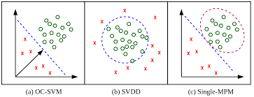
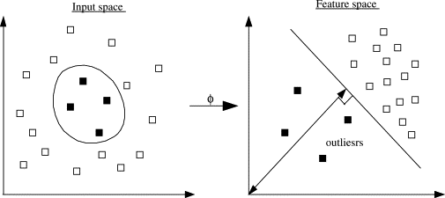
One-class support vector machine (OCSVM)
Support vector machine aims to a max-margin hyperplane in feature space
Input space
Feature space
Origin
Outliers
Notes:
The last model is One-Class Support Vector Machine (OCSVM), which is similar to regular SVM except that it deals with a training data consisting of only one class.
Similar to regular SVM, OCSVM first embeds data in a feature space with high dimensionality. And then, in this feature space, it aims to find a max-margin hyperplane to separate the origin and the data points. It initially is used for find the outliers.
**Radial Basis Function (RBF) kernel, default for one-class learning
A regular SVM for classification finds a max-margin hyperplane that seperates the positive examples from the negative ones. True positive and true negatives. Here we only have true positive data, so we can use one-class SVM.
By changing a parameter v, it can allow us to switch the margin and define the outliers. Higher v, narrower boundary, fewer outliers will be detected.

Slide 38
Different clustering models
Notes:
However, the model fails to assign all phototagged DA neurons in the same cluster with a TP rate of 62.5%

Slide 39
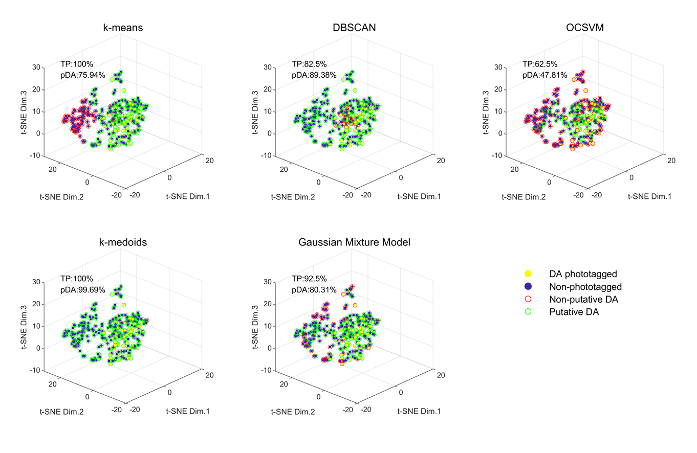
Evaluations of the clustering methods
Accuracy
TPR & pDA proportion
The Calinski-Harabasz index
Stability
Notes:
https://zhuanlan.zhihu.com/p/53840697
Intra-cluster: similar
Inter-cluster: dissimilar
Hence by comparing the accuracy as an external validation, K-means and GMM will be chosen for the subquent comparisons.

Slide 40
Evaluations of the clustering methods
Accuracy
The Calinski-Harabasz index
The ratio of the sum of inter-clusters variance to within-cluster variance for all clusters
Stability
Notes:
https://zhuanlan.zhihu.com/p/53840697
Intra-cluster: similar
Inter-cluster: dissimilar
To use the internal information of the clustering process the evaluate the goodness of a clustering structure, I measured The Calinski-Harabasz index from GMM and k-means model. The ratio of the sum of inter-clusters variance to within-cluster variance for all clusters Higher the score , the better the performances.

Slide 41
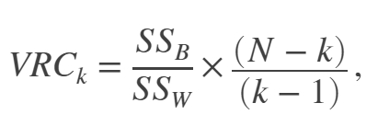
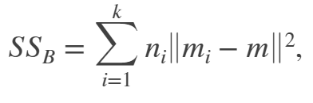
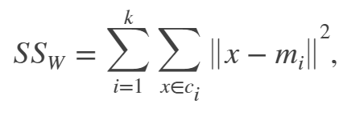
The Calinski-Harabasz index
Inter-clusters variance (ni: the number of observations in cluster i; mi: cluster centroid; m: the overall mean of the sample data )
Within-cluster variance (x: a data point; c: cluster; mi: cluster centroid)

Slide 42
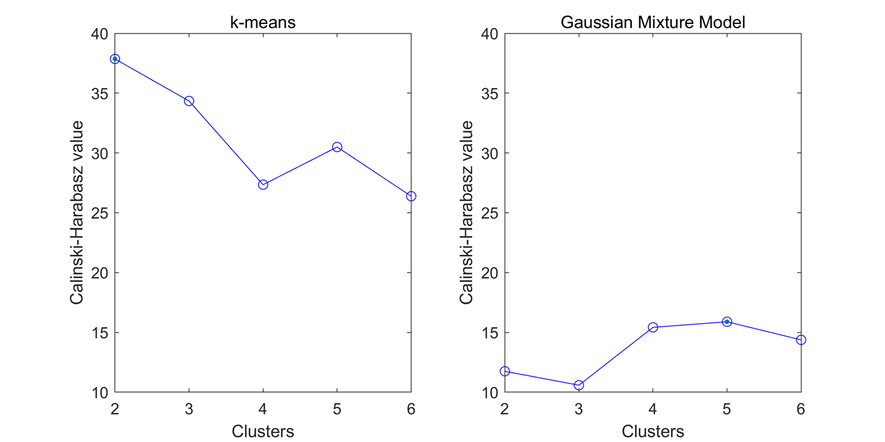
The Calinski-Harabasz index in k-means clustering is higher
Notes:
Here, the x-axis is the predefined number of clusters, and y axis is the Calinski-Harabasz idx. This indx is higher in K-means model regardless of the number of clusters, indicating a better performance. And also in K-means, the number of 2 clusters have the best performance.
** The Calinski-Harabasz index is generally higher for convex clusters than other concepts of clusters, such as density based clusters like those obtained through DBSCAN.

Slide 44
Evaluations of the clustering methods
Accuracy
The Calinski-Harabasz index
Stability
Notes:
https://zhuanlan.zhihu.com/p/53840697
Intra-cluster: similar
Inter-cluster: dissimilar
Also, for practical applications, the stability of a model is very important.

Slide 45
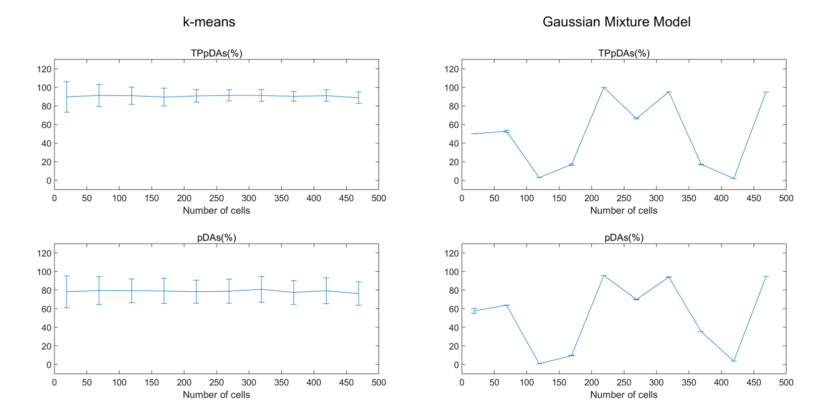
The K-means model is more stable than the GMM
Notes:
K=2
Therefore, I have tested the stability of this model by calculating the TP and pDA with different sample size. Given each sample size, I randomly selected cells and ran each model for 100 times. As for K-means, these two values are very smooth. In contrast, TPpDA changed a lot with different sample size. Threrefore K-means is more stable than GMM
Each group random selection n = 100.

Slide 46
Classification of VTA neurons by K-means clustering
Notes:
Collectively, K-means is better than GMM because of its stability and its better performance.
Here are the classification of VTA neurons by the K-means model. The blue is true DA. The green and red are Pda and non-Pda respectively. After the clustering, tDA group and pDA cluster have wider waveforms compared to Non-pDA cluster. As for the ISIs from representive neurons, the firing patterns is more skewed to left. And has higher firing frequency, since the count is high

Slide 47
Classification of VTA neurons by K-means clustering
Notes:
Result of the clustering analysis in scatter plot with histograms. Each data point represents 1 neuron. Baseline ﬁring rate is plotted in the ordinate, spike width and peak-to-trough duration are plotted in the abscissa. We can see that pDA have lower firing rate and wider spike width. As for the peak-to-trough duration, non-pDA have narrower peak-to-trough duration. So, it reflects firing rate, spike width and peak-to-trough are important features for clustering. And also, this is consistent with previous found electrophysiological properties.

Slide 49
Predictive Analysis
Euclidean distance predictions
The Euclidean distance between data points and centroids
A linear SVM classifier
n=169
n=169
Notes:
After that I was wondering whether such clustering is effective to predict new neurons. The first strategy I used is to use the centroids in the training dataset from the k-means model. By calculating the Euclidean distance between data points from the testing dataset and centroid in each cluster, each fata point from the testing dataset is assigned to pDA or Non-Pda group. TP: pDA:75.74. So it can work well.
Another strategy I used is by training a llinear SVM classifier on the training dataset by using the labels from K-means model. And then use this classier to predict the neuron type. But the TP rate is not as high as that from the first strategy. Therefore both methods can predict new neurons, and the first method is more sensitive.

Slide 51
Conclusion
Unsupervised clustering methods can link electrophysiological properties’ analysis with optotagging for unbiased and quantitative large-scale putative DA neuron identification

Slide 52
Discussion
Apply optotagging in other neuron types (e.g. GABA, Glu) in the VTA and train a supervised /semi-supervised classifier
Feature importance estimation
Improve DBSCAN
Notes:
One limitation of my project is that here we only have true-positive data, so unsupervised methods are preferred. But, there are no true negative data. Therefore, in the future, optotagging can be applied in other neuron types in the VTA region, so most neurons can be labeled. Finally, we can train a supervised and semi-supervised classifer.
Second, to quantify each feature’s contribution to the decoding, we can utilize feature importance estimation. Maybe we can have a better understanding of the electrophysiological properties of the DA neurons.
Besides, DBSCAN is not optimized here.

Slide 53

Acknowledgement
Naoshige Uchida (Harvard University), Sara Matias (Harvard University), HyungGoo Kim (Sungkyunkwan University)

Slide 54
Thanks
Any questions?

Slide 55


Slide 56
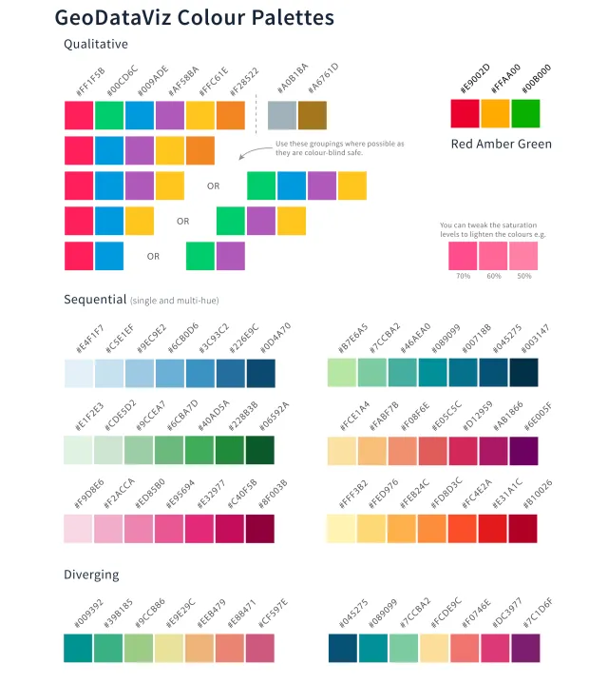
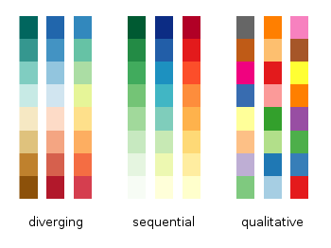
Outline

